Slide 1
Analysis of the COVID-19 Cases Rate and Excess Mortality Rate by Pandemic Wave
Presenters: Shuoyuan Gao, Yiqiao Zhu
April, 17, 2025

Slide 2
Motivation and Objective
Research Motivation
Understanding Temporal Trends
The COVID-19 pandemic unfolded in distinct waves, each with different dynamics and severity.
Segmenting the pandemic period helps reveal how public health response and virus virulence evolved.
2. Model Generalizability Challenge
Predictive models trained on one wave may not perform well across other pandemic phases.
Changing dynamics (e.g., variants, healthcare capacity) affect excess mortality patterns.
Research Objective:
Segment the pandemic timeline (2020–2024) into three waves using data-driven justifications.
Quantitatively evaluate how well models trained on one COVID-19 wave generalize to predict excess mortality in another. Use linear regression, LOESS, and spline methods to assess model robustness and capture nonlinear trends.

Slide 3
Data Source
Dataset Overview
Population Data Source: U.S. Census Bureau, 2024 National and State Estimates
COVID-19 Case Source: CDC Weekly United States COVID-19 Cases and Deaths by State
COVID-19 Death Source: CDC Provisional COVID-19 Death Counts by Week Ending Date and State
Time Frame: 2020 – 2024
Origin: United States, Puerto Rico
Advantages of Dataset:
Comprehensive coverage across all U.S. states.
Enables temporal and spatial comparison of pandemic impacts.
Disadvantages of Dataset
Variability in reporting practices across states and time.

Slide 4
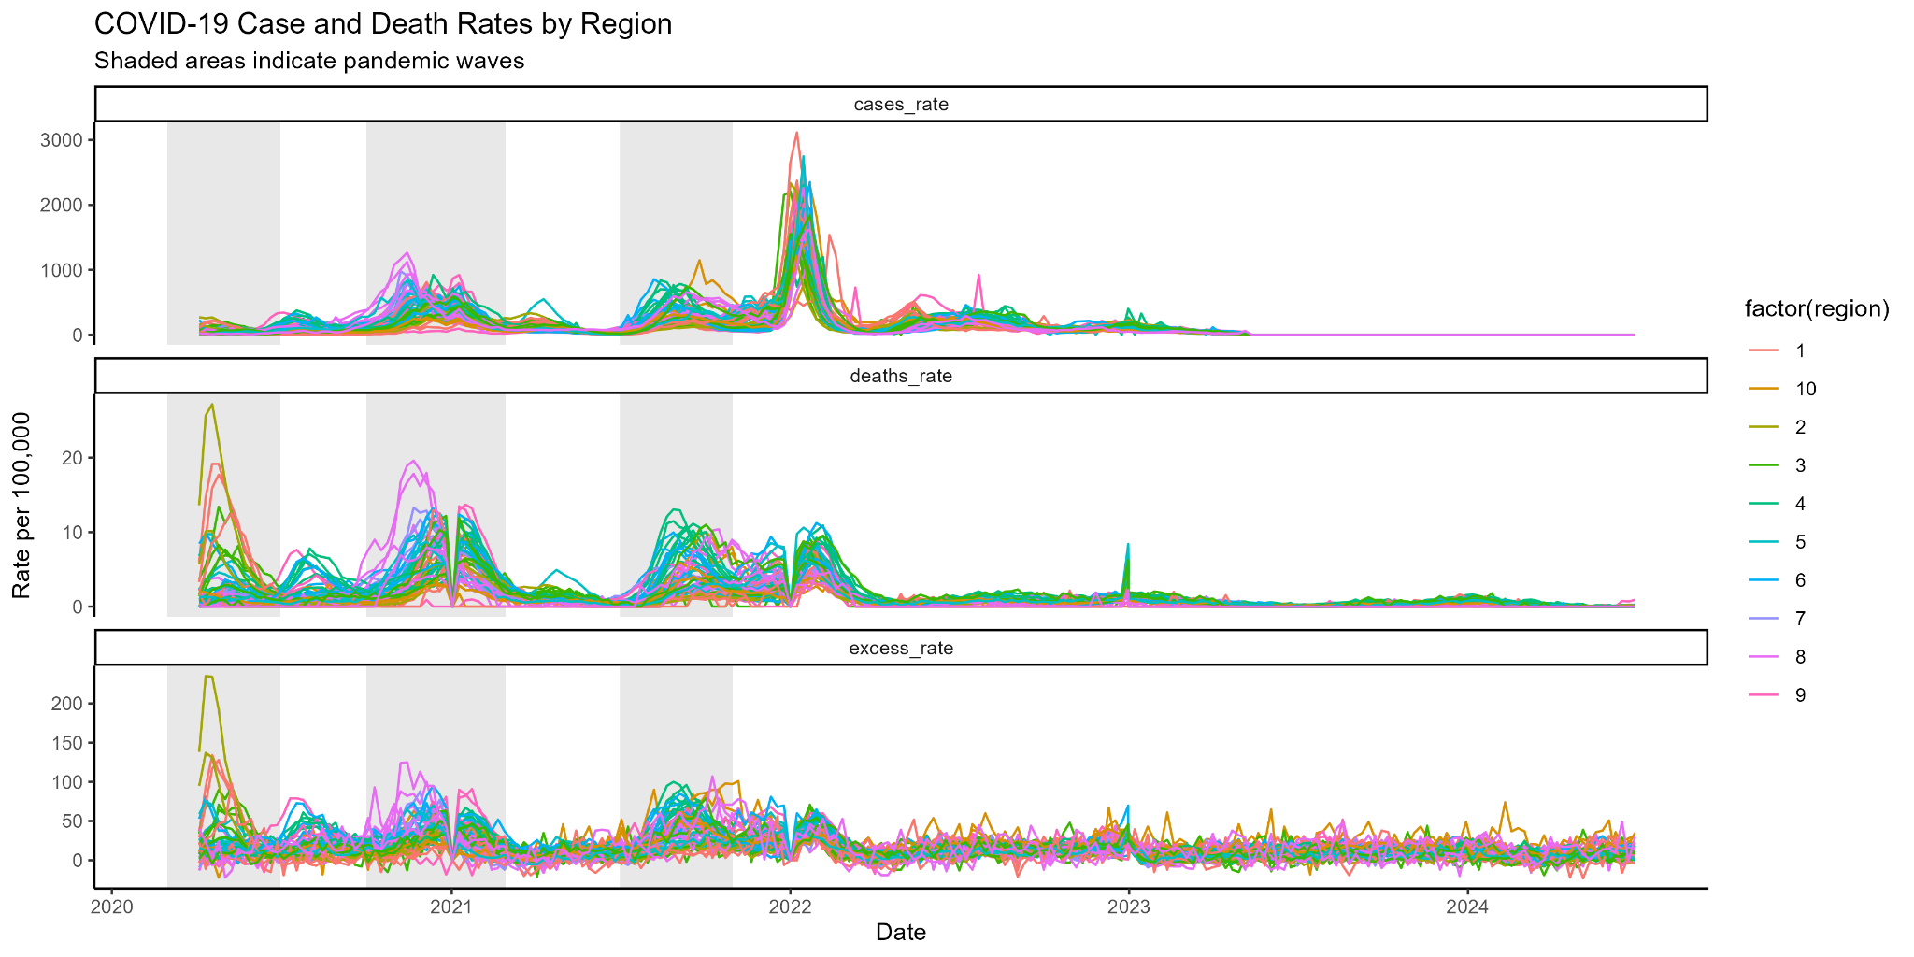
Task1
Wave1: 2020.3.1 - 2020.6.30 Wave2: 2020.10.1 - 2021.2.28 Wave3: 2021.7.1 - 2021.10.31

Slide 5
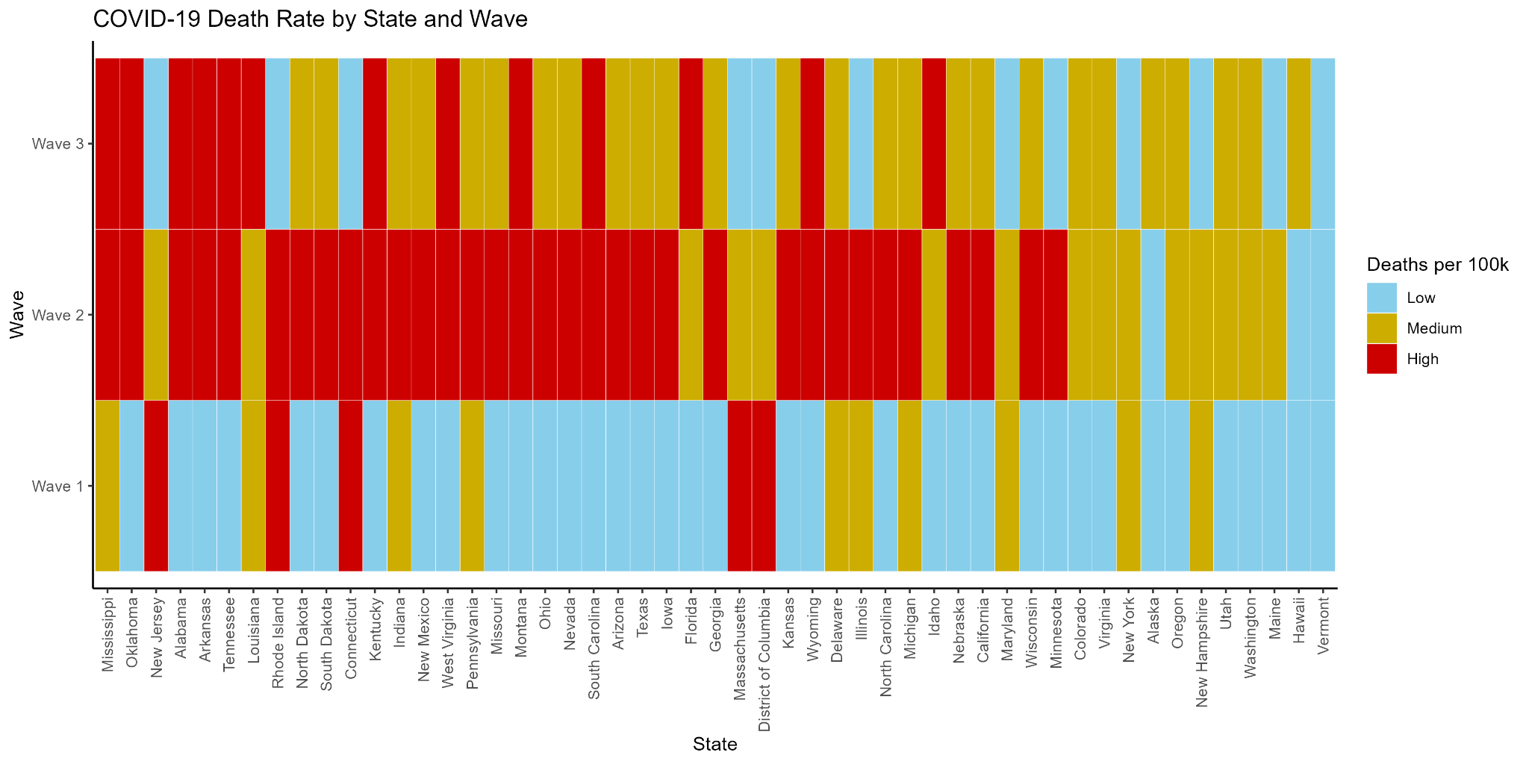
Task2 - Death Rate

Slide 6
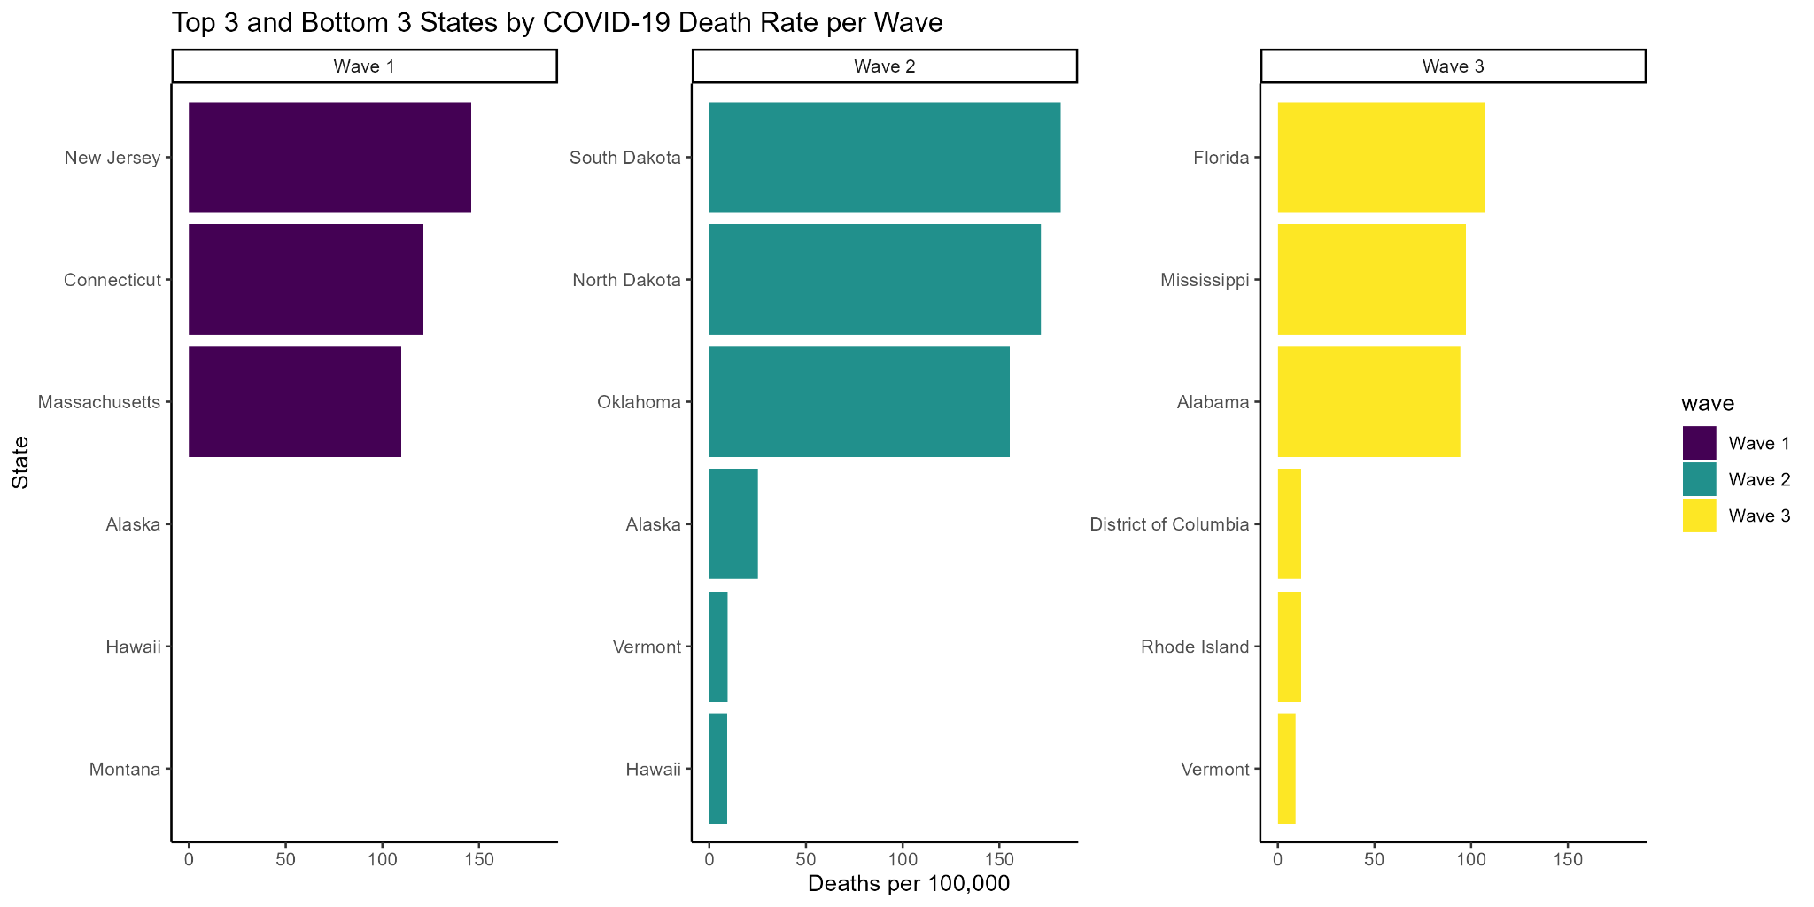
Task2

Slide 7
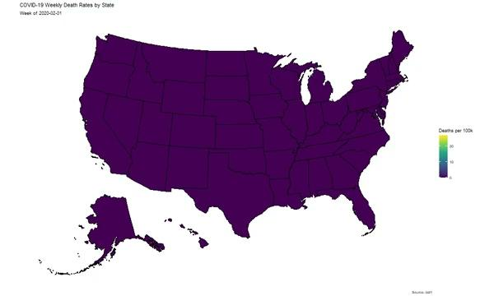

Slide 8
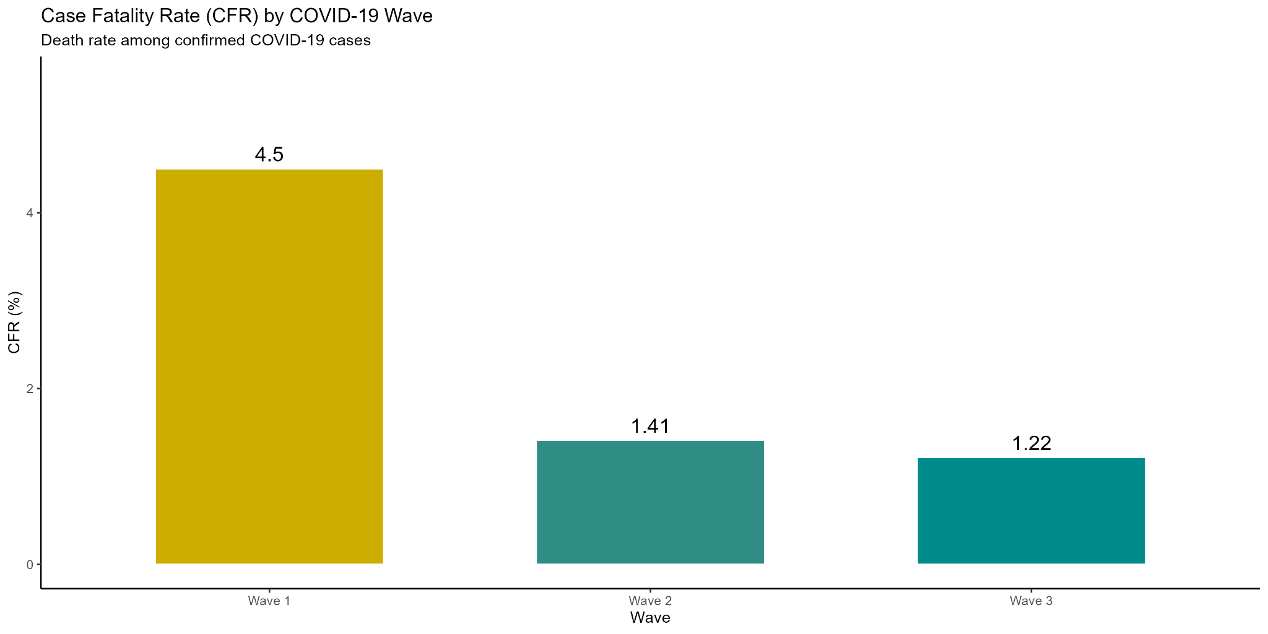


Task3 - virulence change

Slide 9
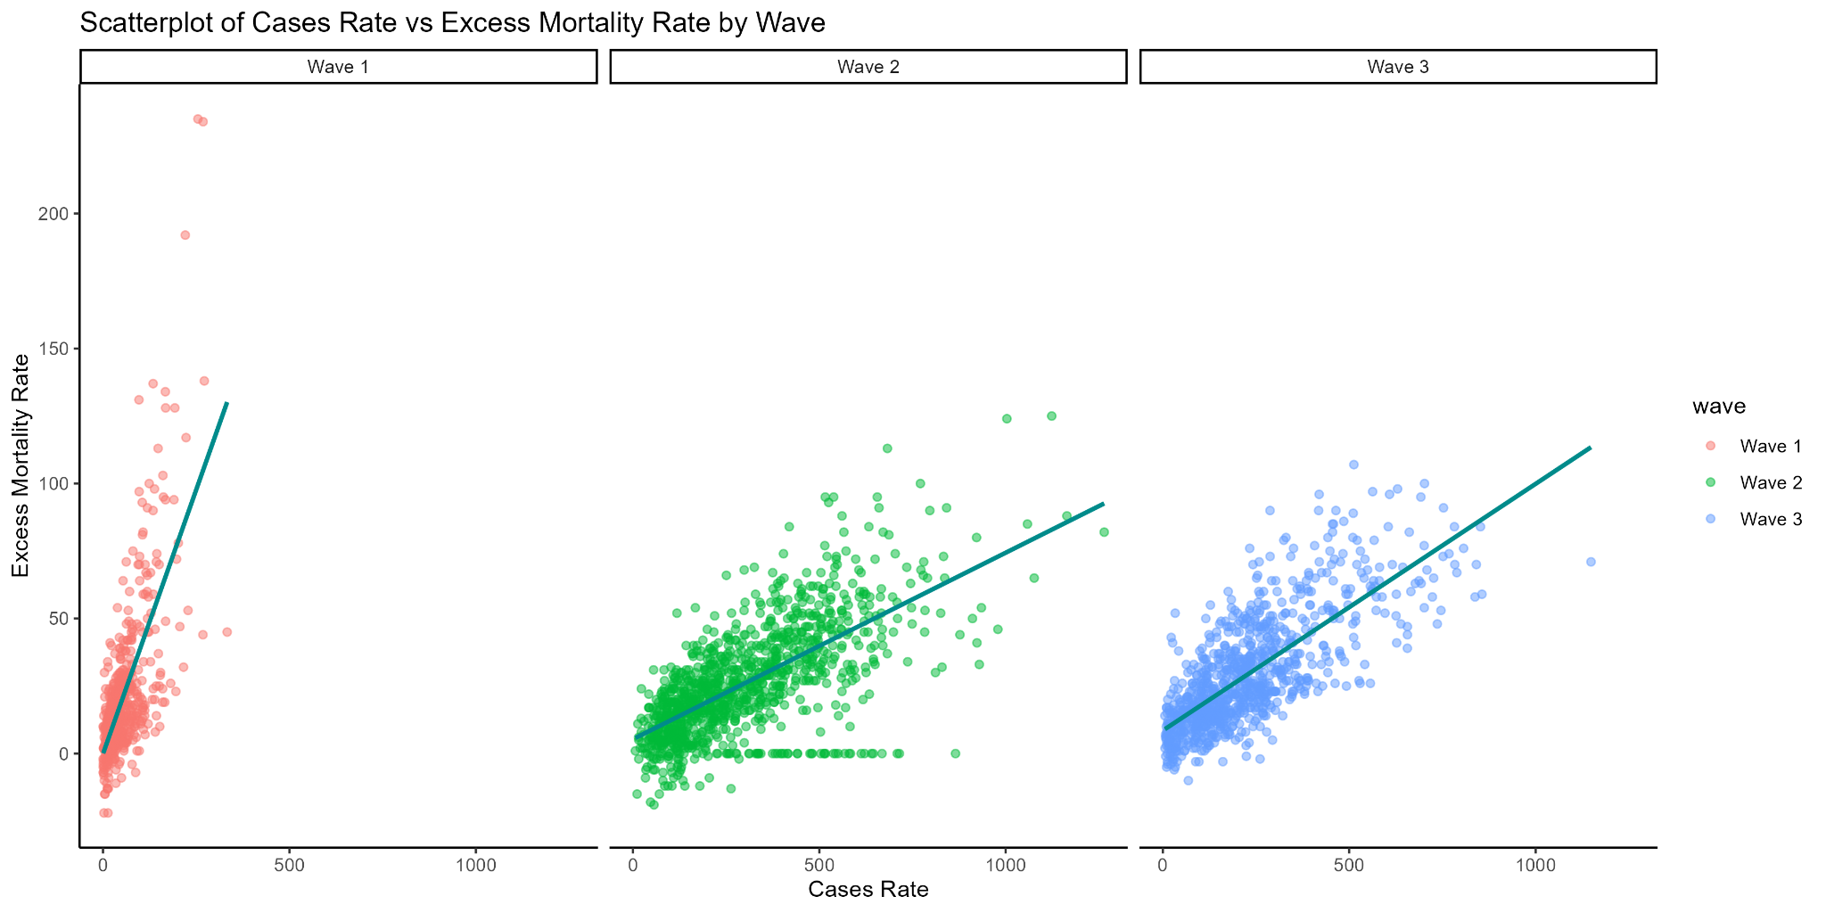
Task4

Slide 10
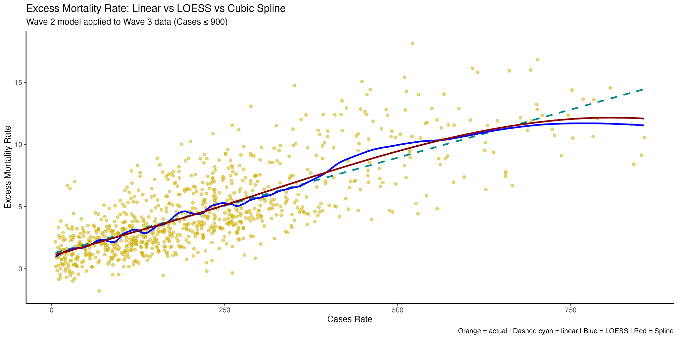
Task4

Slide 11
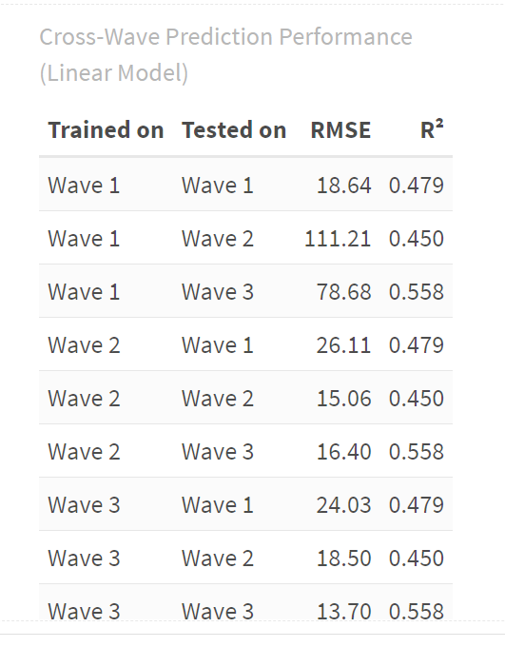
Task4
Models trained on Wave 1 generalize poorly to other waves.
Models trained on Wave 2 and Wave 3 demonstrate better cross-wave generalizability, relatively lower RMSE and stable R^2.
The poor performance of cross-wave prediction indicates that there are significant differences in data distribution between different waves of the epidemic.

Slide 12
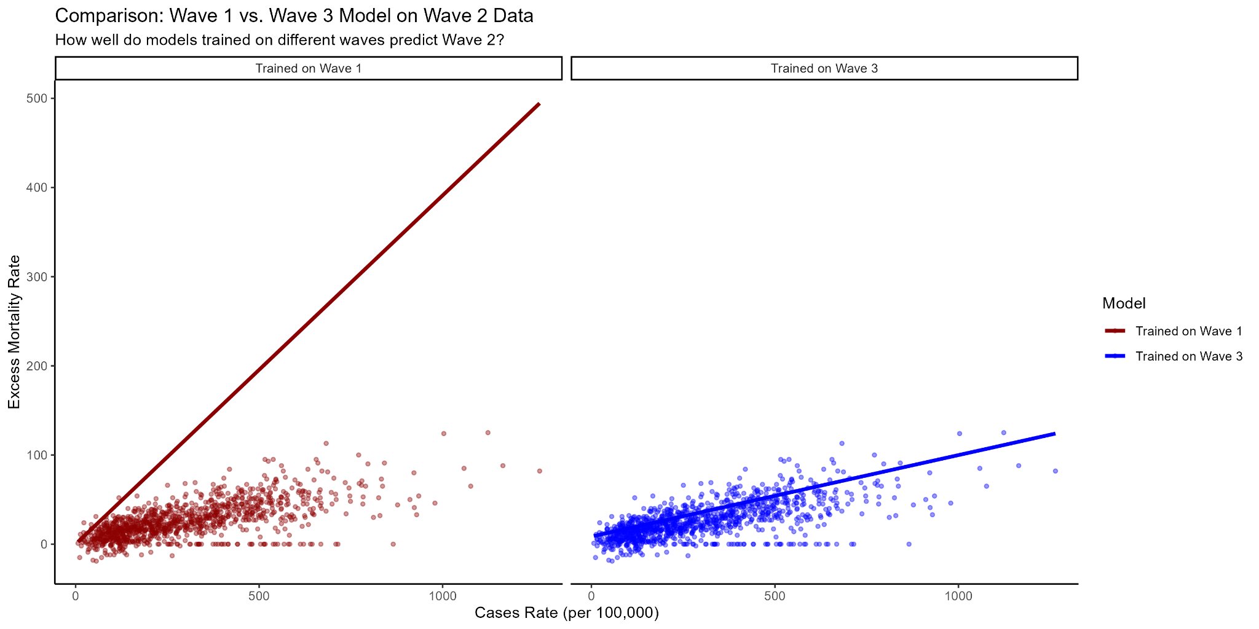
Task4

Slide 13
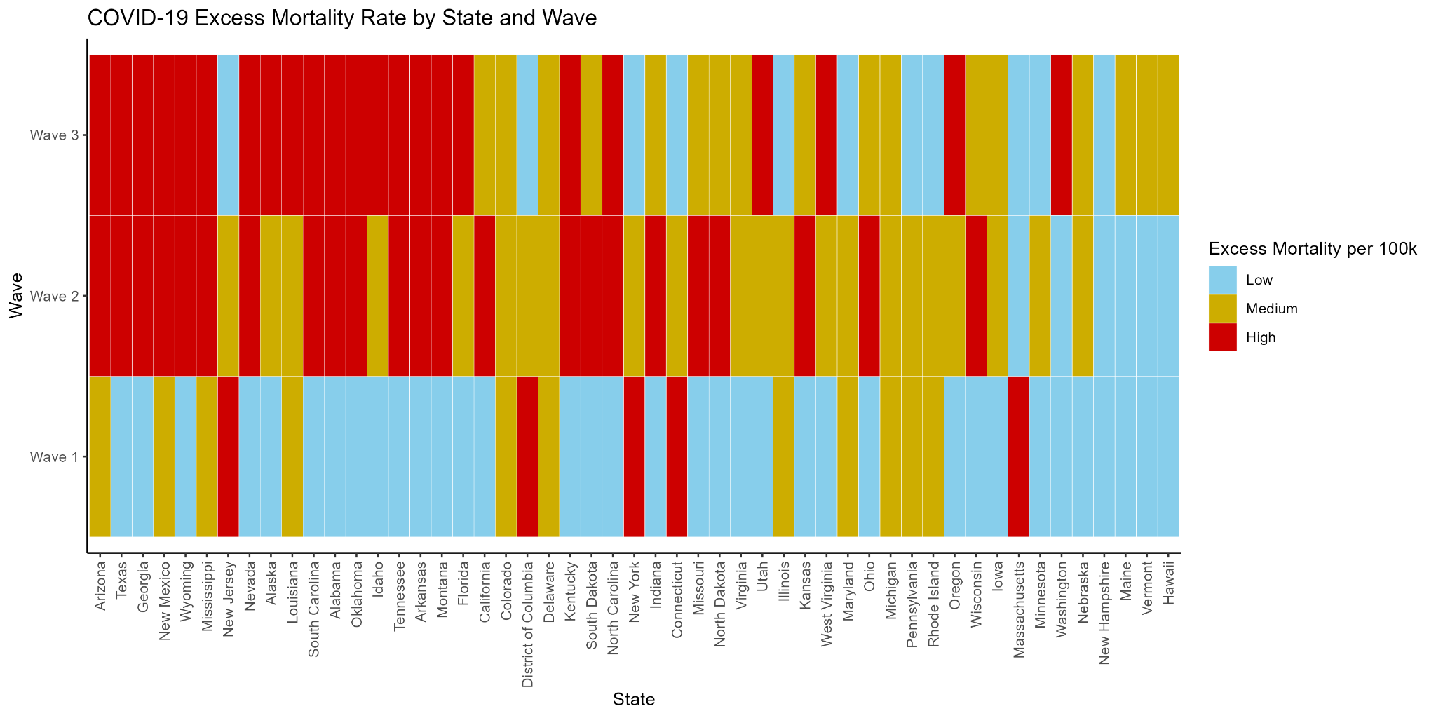
Task5 - Excess Mortality Rate

Slide 14
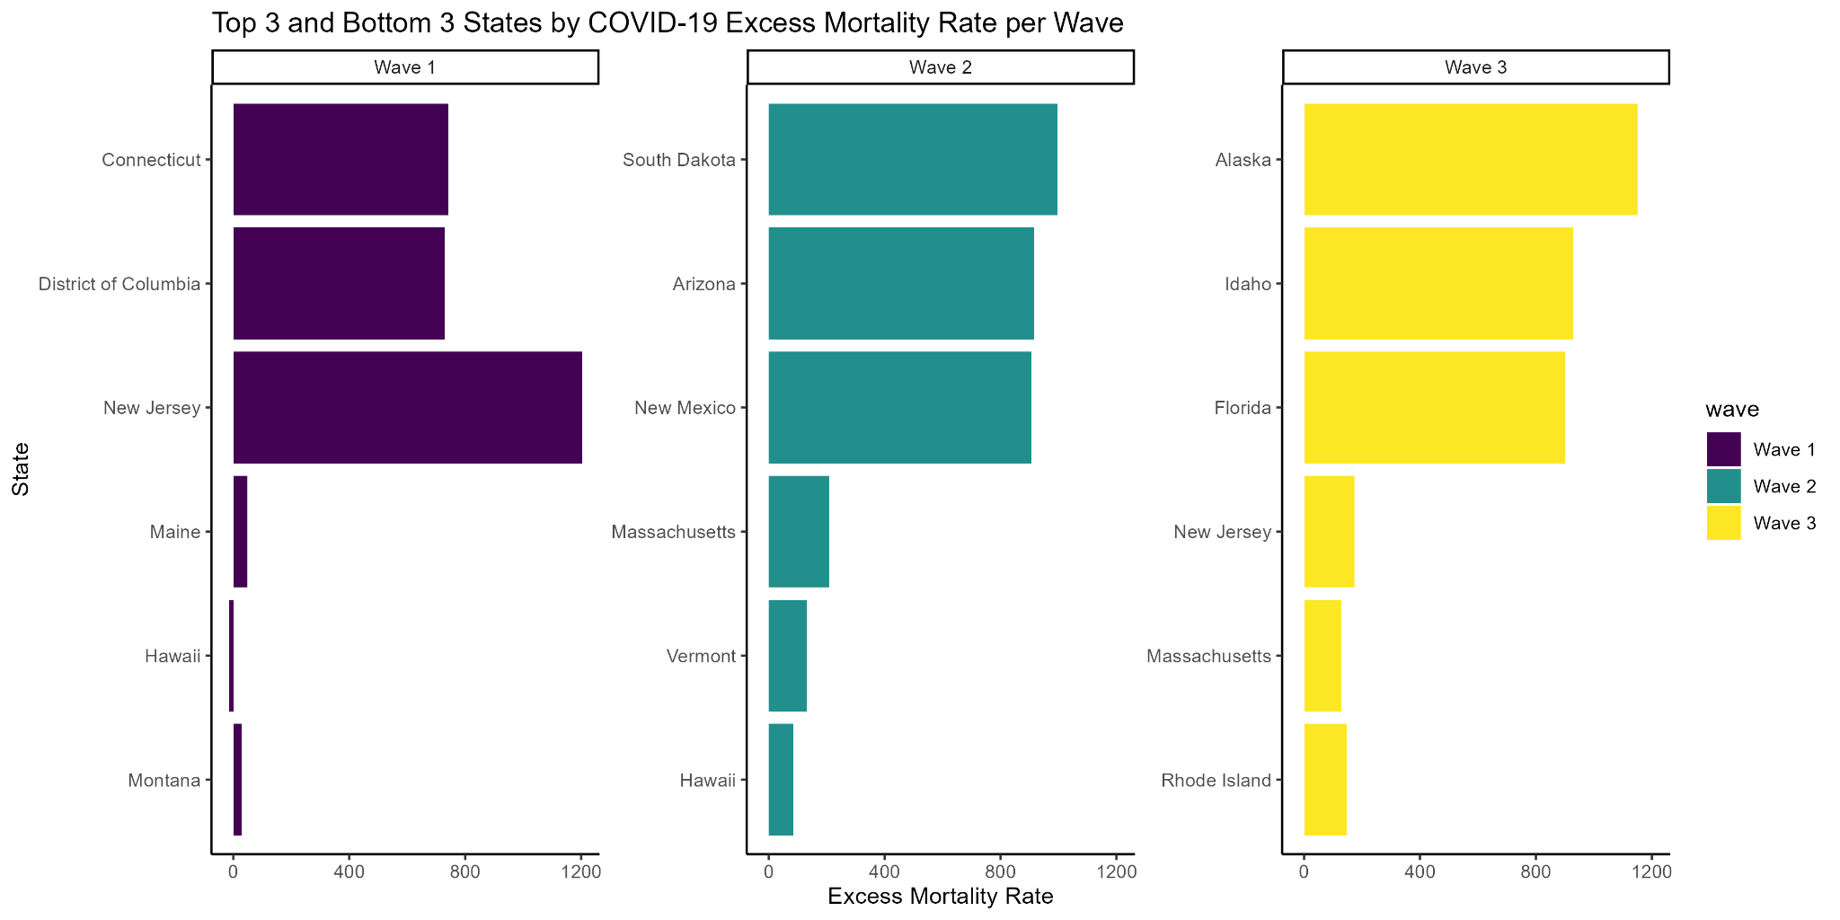
Task5

Slide 15
Limitations and Future Work
Population estimate quality
Annual state-level population estimates may contain error or reporting lags, especially during high-migration periods like 2020–2021
Cross-wave prediction performance is less effective.
Wave 2 → Wave 2 or Wave 3 → Wave 3 have lower RMSE and higher R^2.
Try to add time factor in the model.

Slide 16
Thank you!

